Slide 1
Google Play Store

Slide 2

DATASET- Google PlayStore
Dataset-Link : https://www.kaggle.com/gauthamp10/google-playstore-apps

Slide 3
PROBLEM STATEMENT
An enlargement of smartphones is driving the rapid development of mobile app stores. Nowadays, the two largest platforms for app distribution are Google Play-store and Apple App Store. We chose Google Play-store data for our project. Google Play-store has more than 10 million apps. It is divided into various categories like action, adventure, arcade, music, finance, sports, tools, etc.
There are various factors that can lead users to download any particular app. Our goal is to help app developers and app organizations to know what is the motivating factor for many people to download an app. It will also find out that how these factors affect any person's decision to download an app. We would like to analyse some data fields like category, price, Ad supported, ratings, size and installs for this purpose and find out how these fields are related to each other.

Slide 4

Descriptive Statistics And EDA

Slide 5
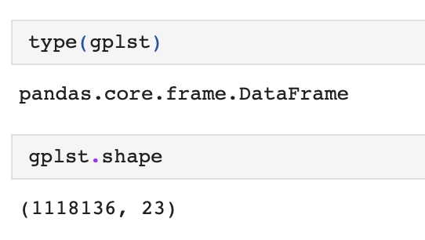
Understanding the Dataset
Dimensions & Type of Dataset
Dataset :-
Google-Playstore.csv

Slide 6
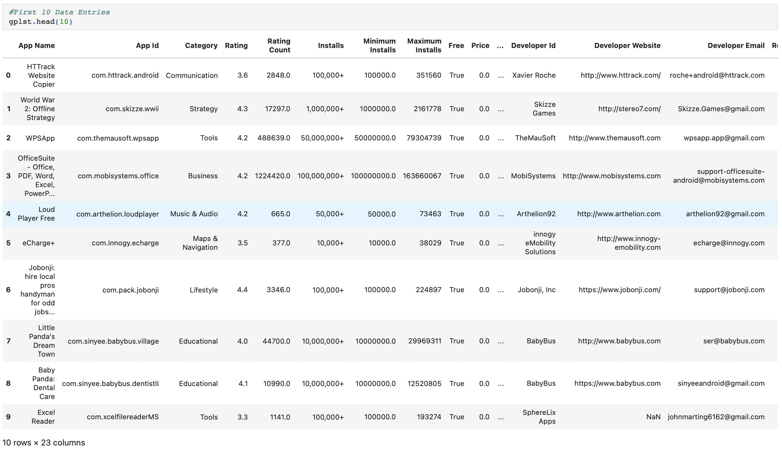
Head()

Slide 7
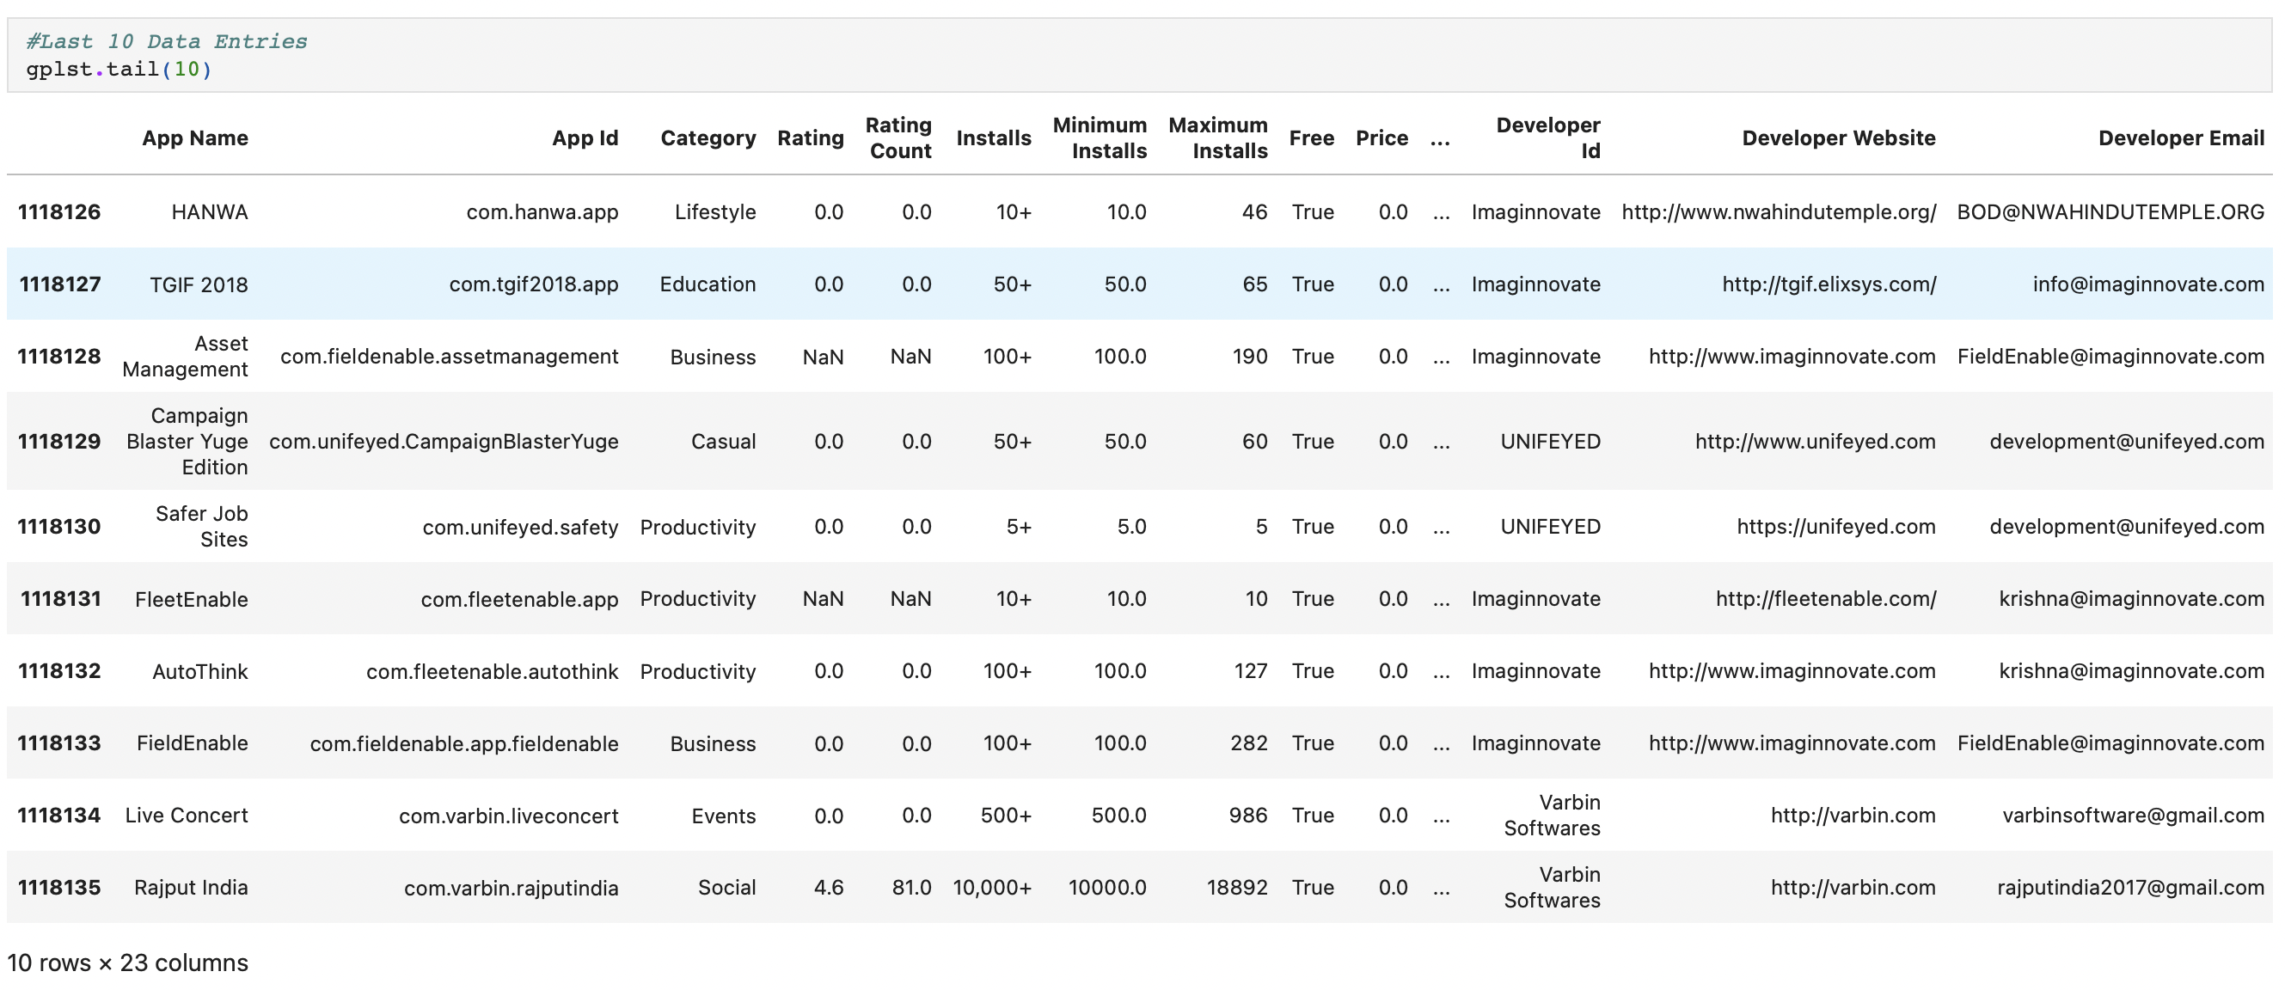
Tail()

Slide 8
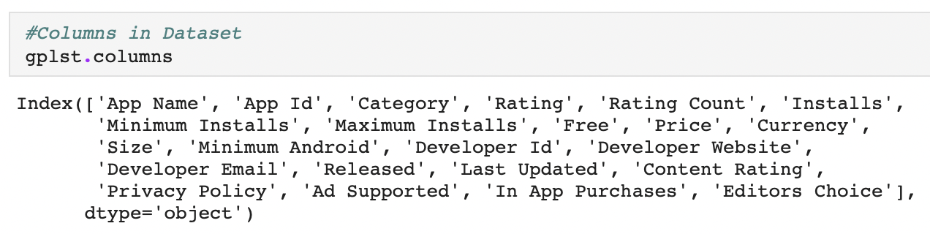
Columns in Dataset

Slide 9
Finding unique values
We will use info() function for datatype, count and other parameters .
Also we nunique() functions helps us to find out the total unique values as it can be further classifies as numeric, ordinal or categorical.

Slide 10
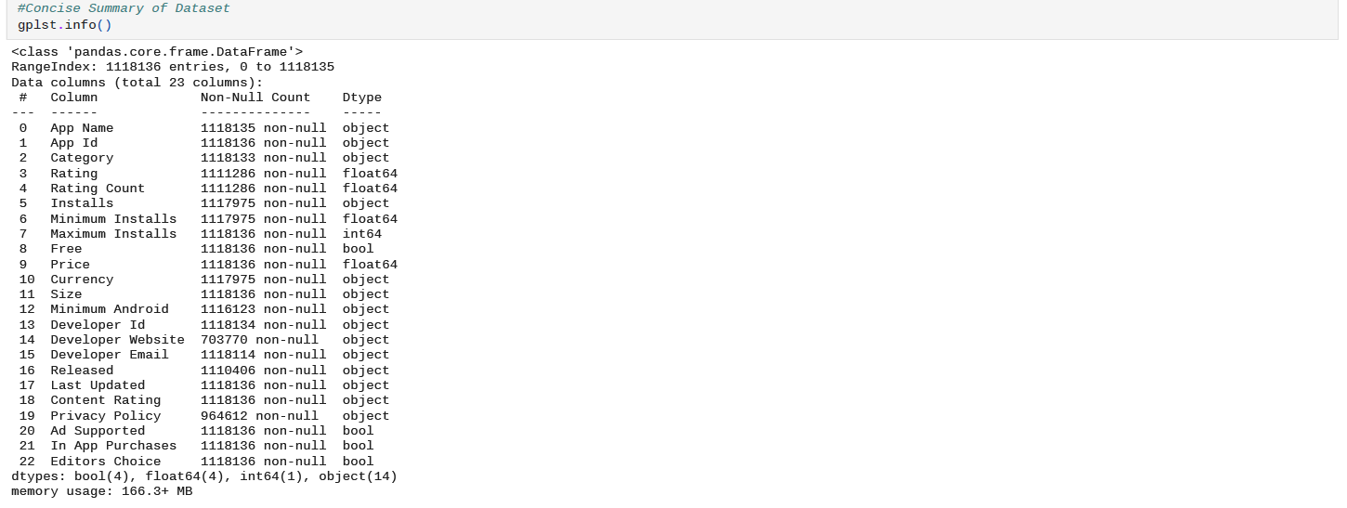
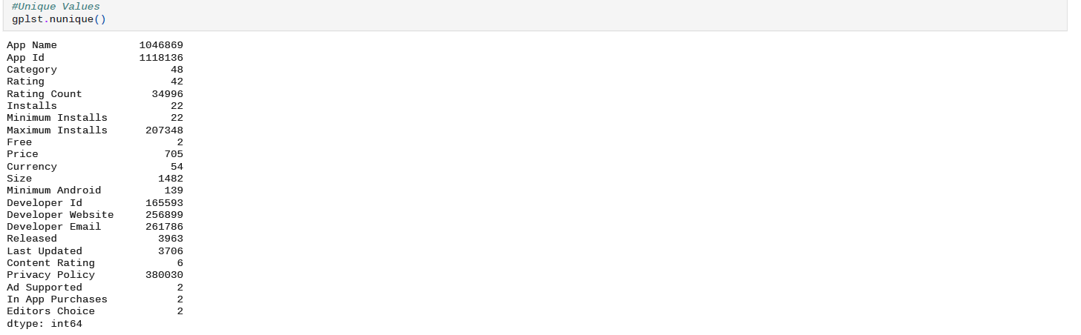
Summary & Unique values

Slide 11
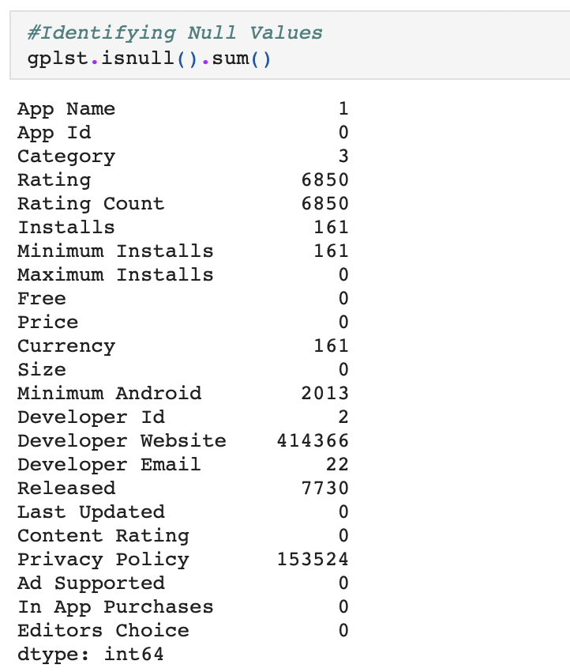
Null values

Slide 12
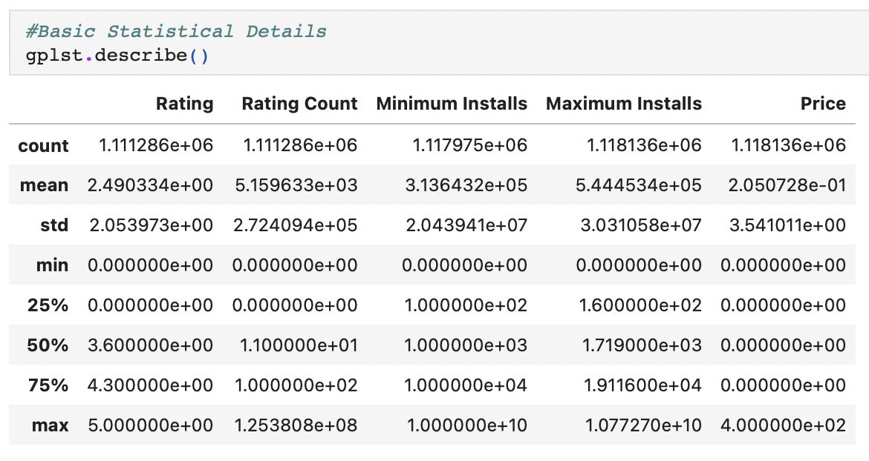
Basic Statistical Details

Slide 13
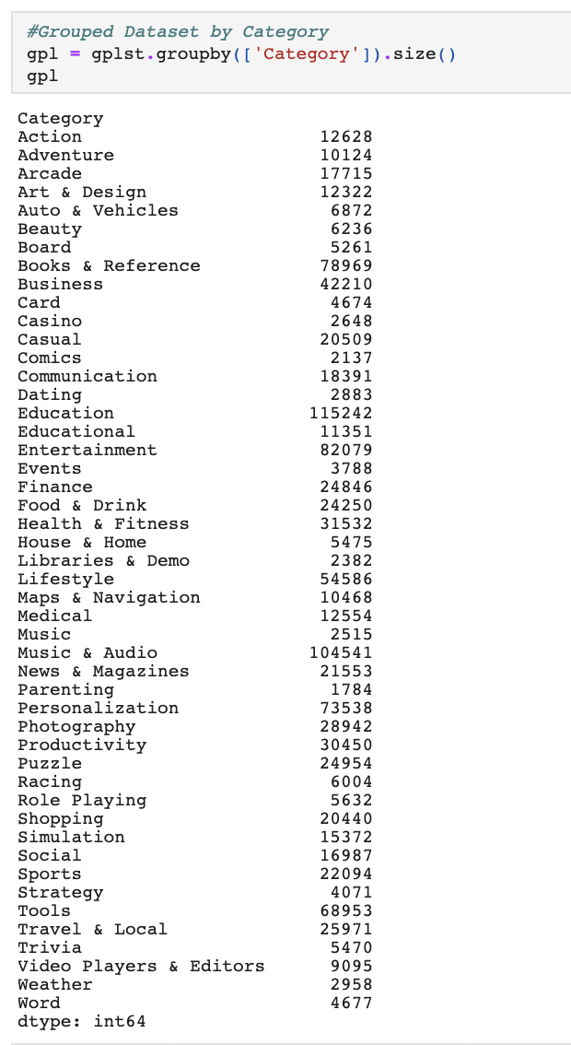
Grouped Dataset by ‘Category’

Slide 14

Visualizations

Slide 15
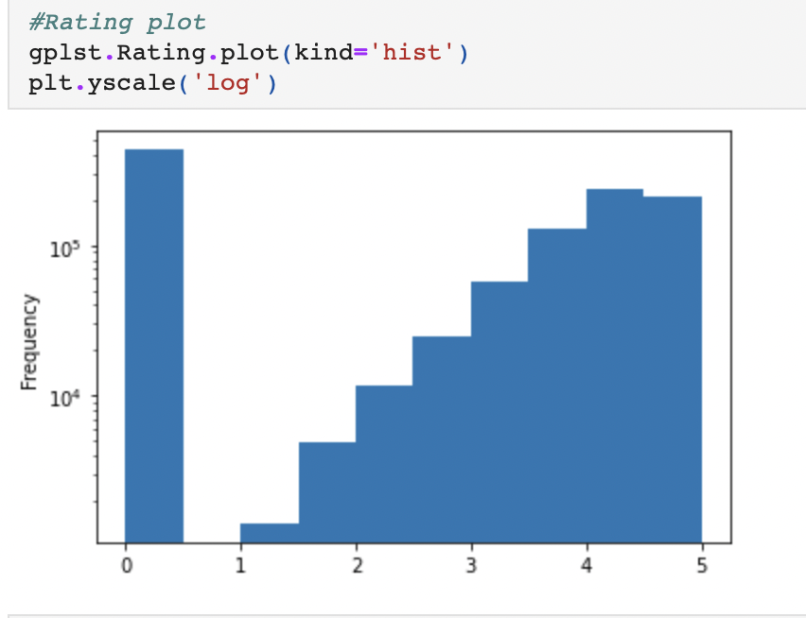
Rating Plot

Slide 16
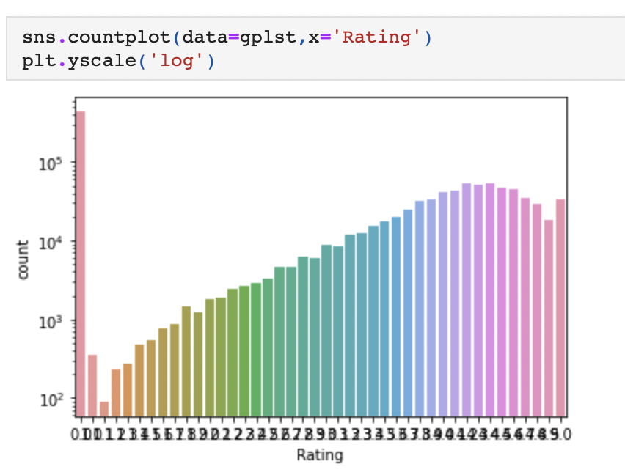
Count Plot

Slide 17
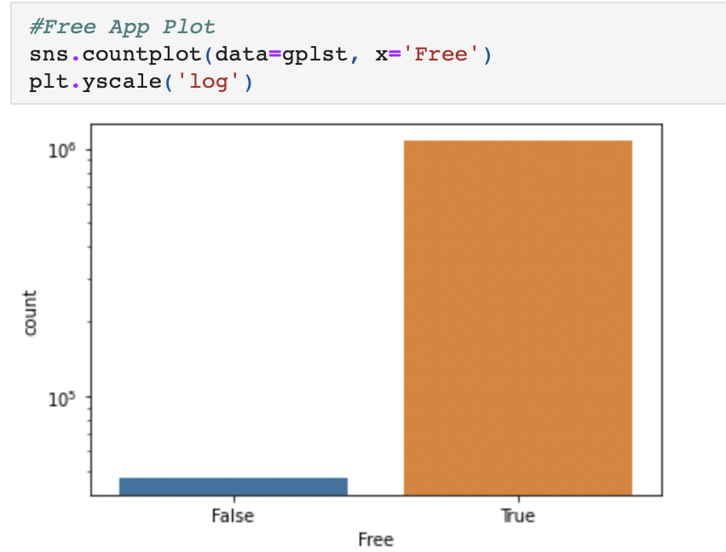
Free-App Plot

Slide 18
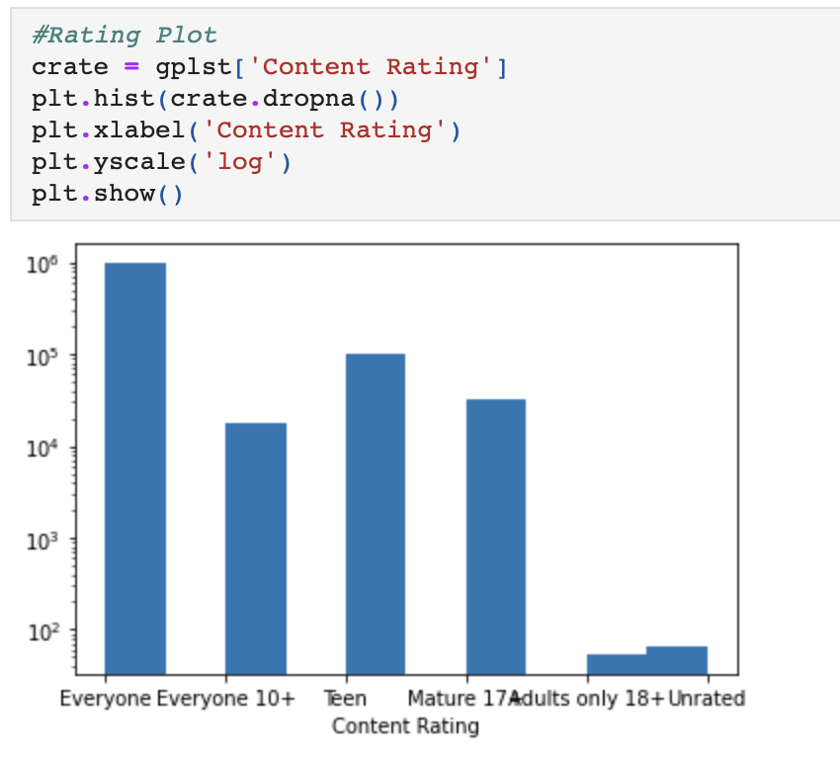
Rating Plot

Slide 19
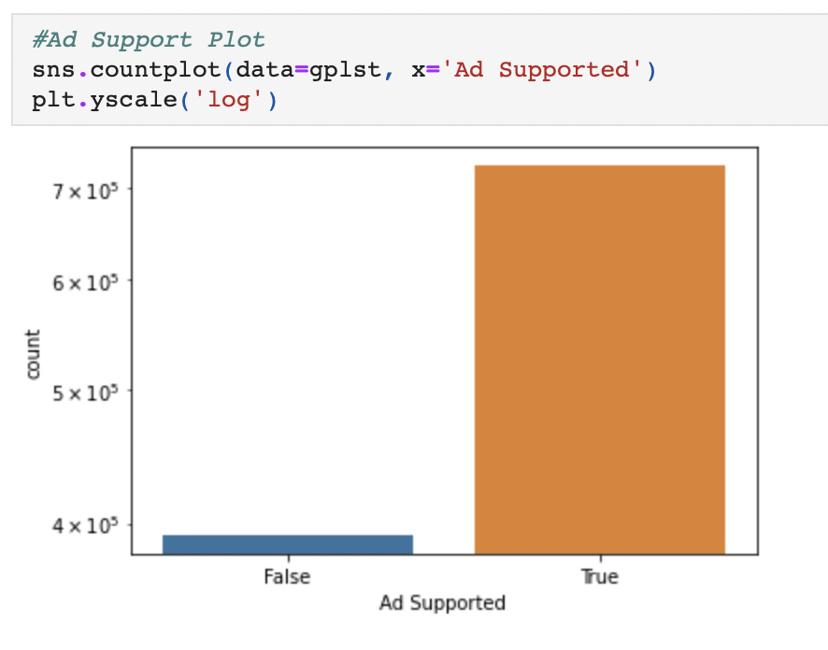
Ad-Support Plot

Slide 20
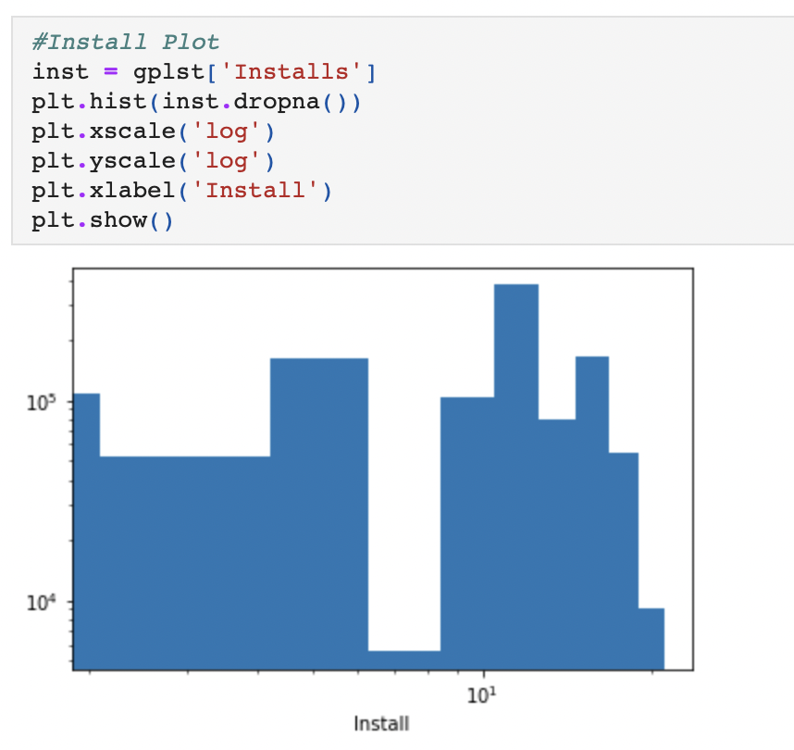
Install Plot

Slide 21
Finding outliers through boxplots

Slide 22
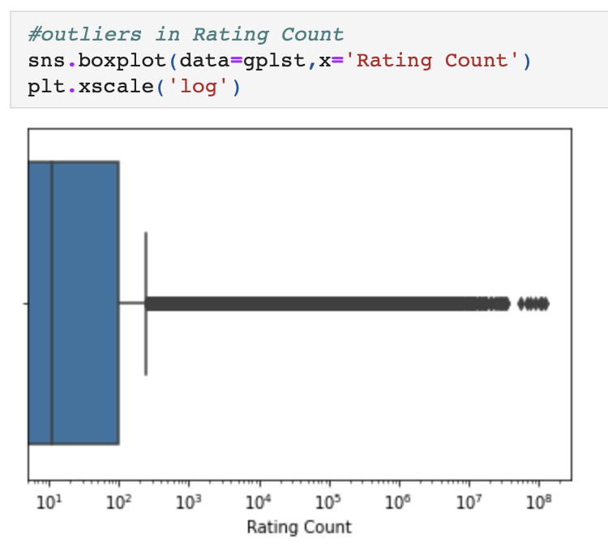
Outliers in Rating Count

Slide 23
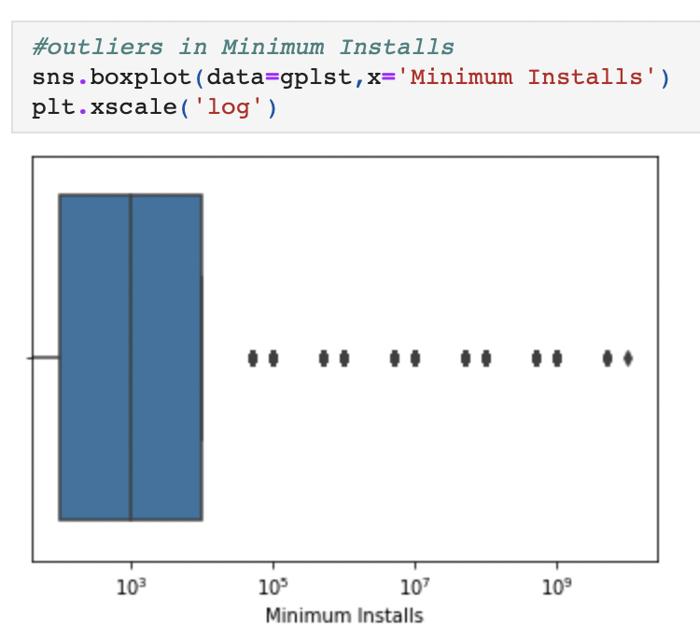
Outliers in Minimum Installs

Slide 24
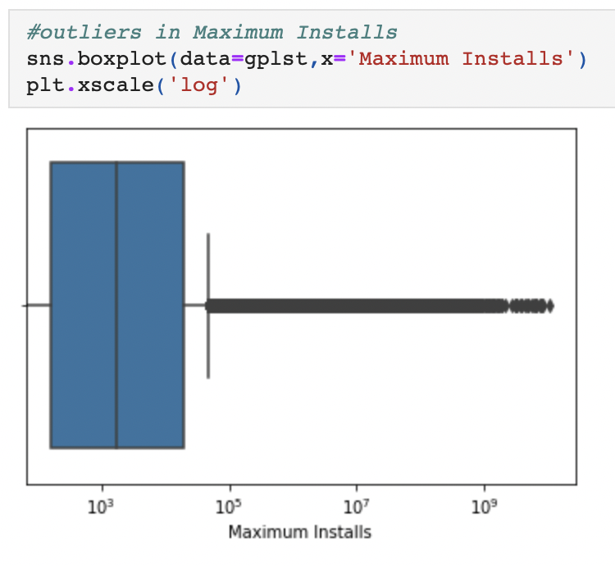
Outliers in Maximum Installs

Slide 25
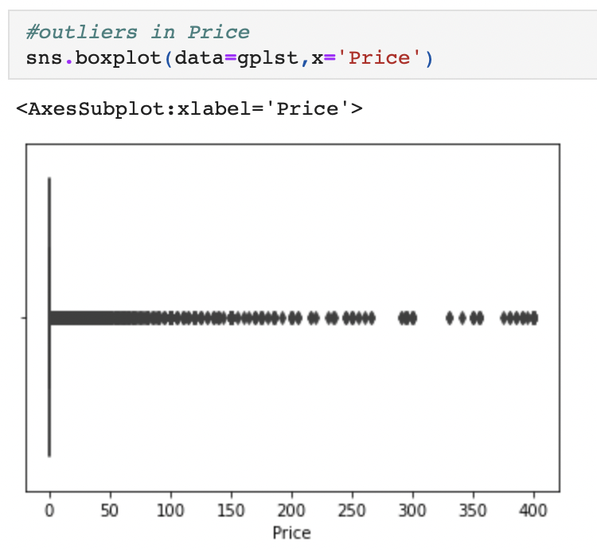
Outliers in Price

Slide 26
Data Cleaning

Slide 27
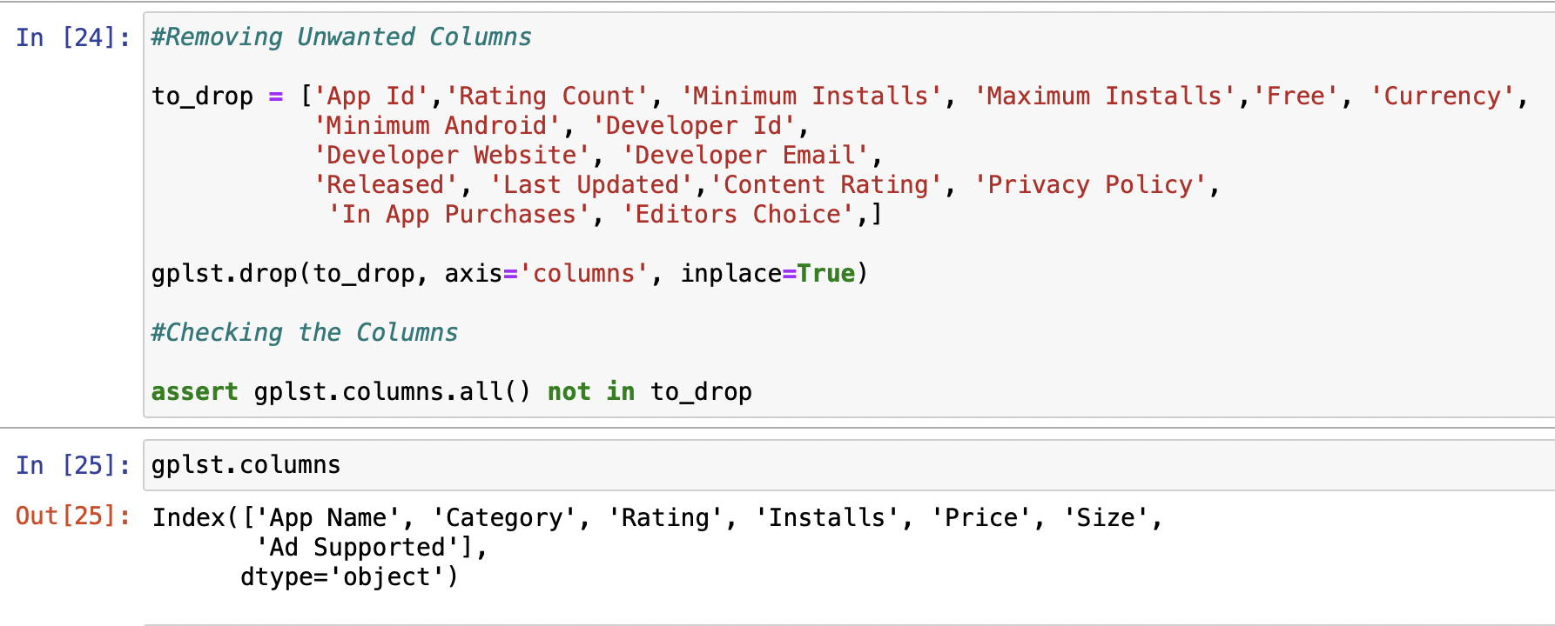
Removing Unwanted Columns From Dataset

Slide 28
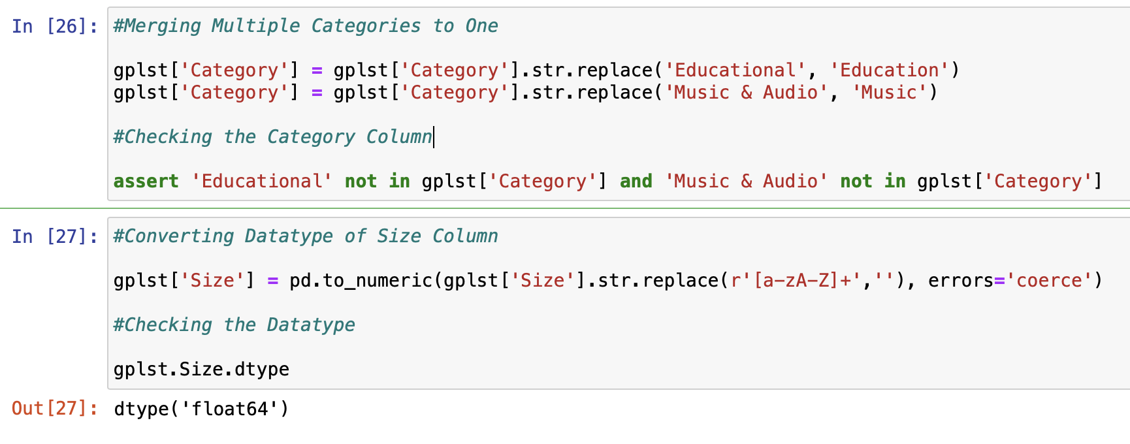
Merging multiple categories into one
&
Converting datatype of Size Column

Slide 29
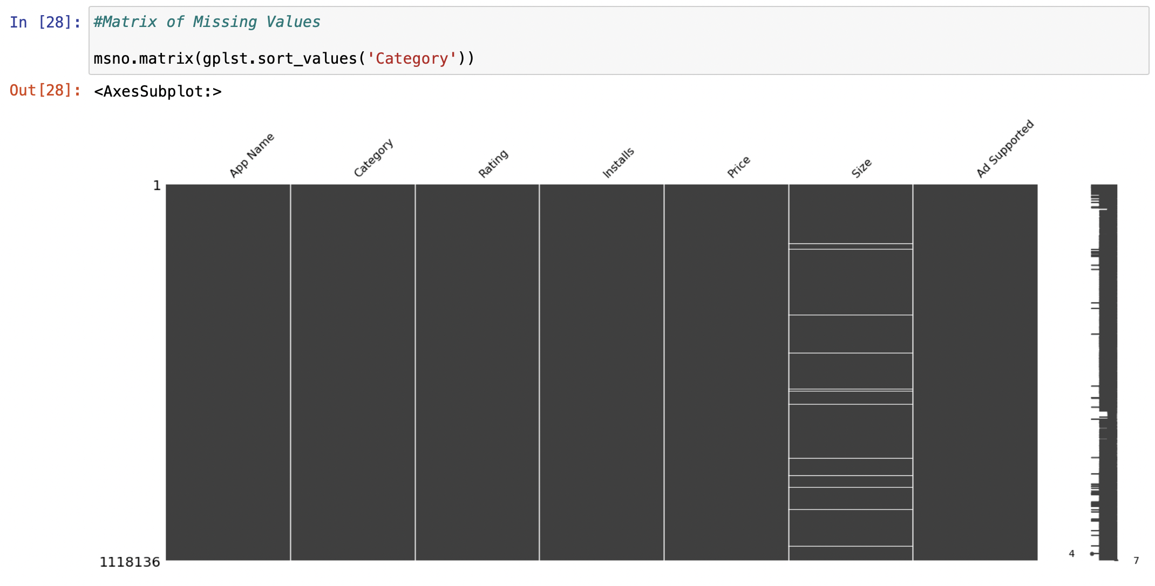
Matrix of
Missing Values

Slide 30
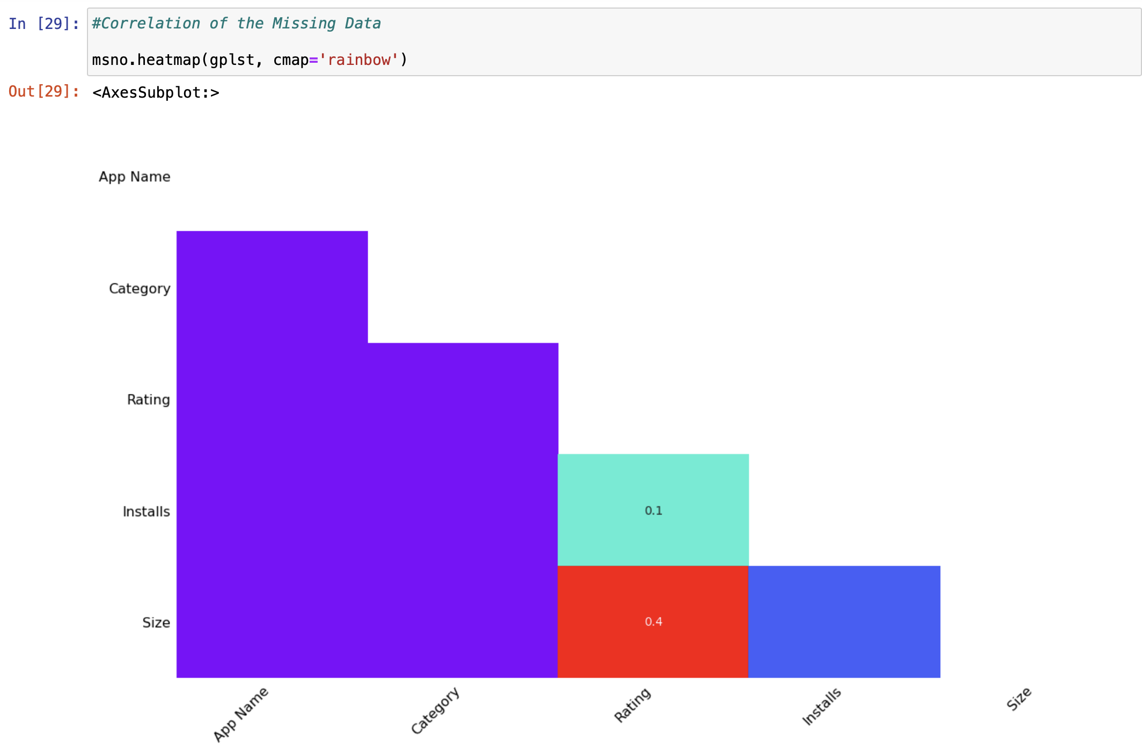
Correlation
of the Missing Data

Slide 31
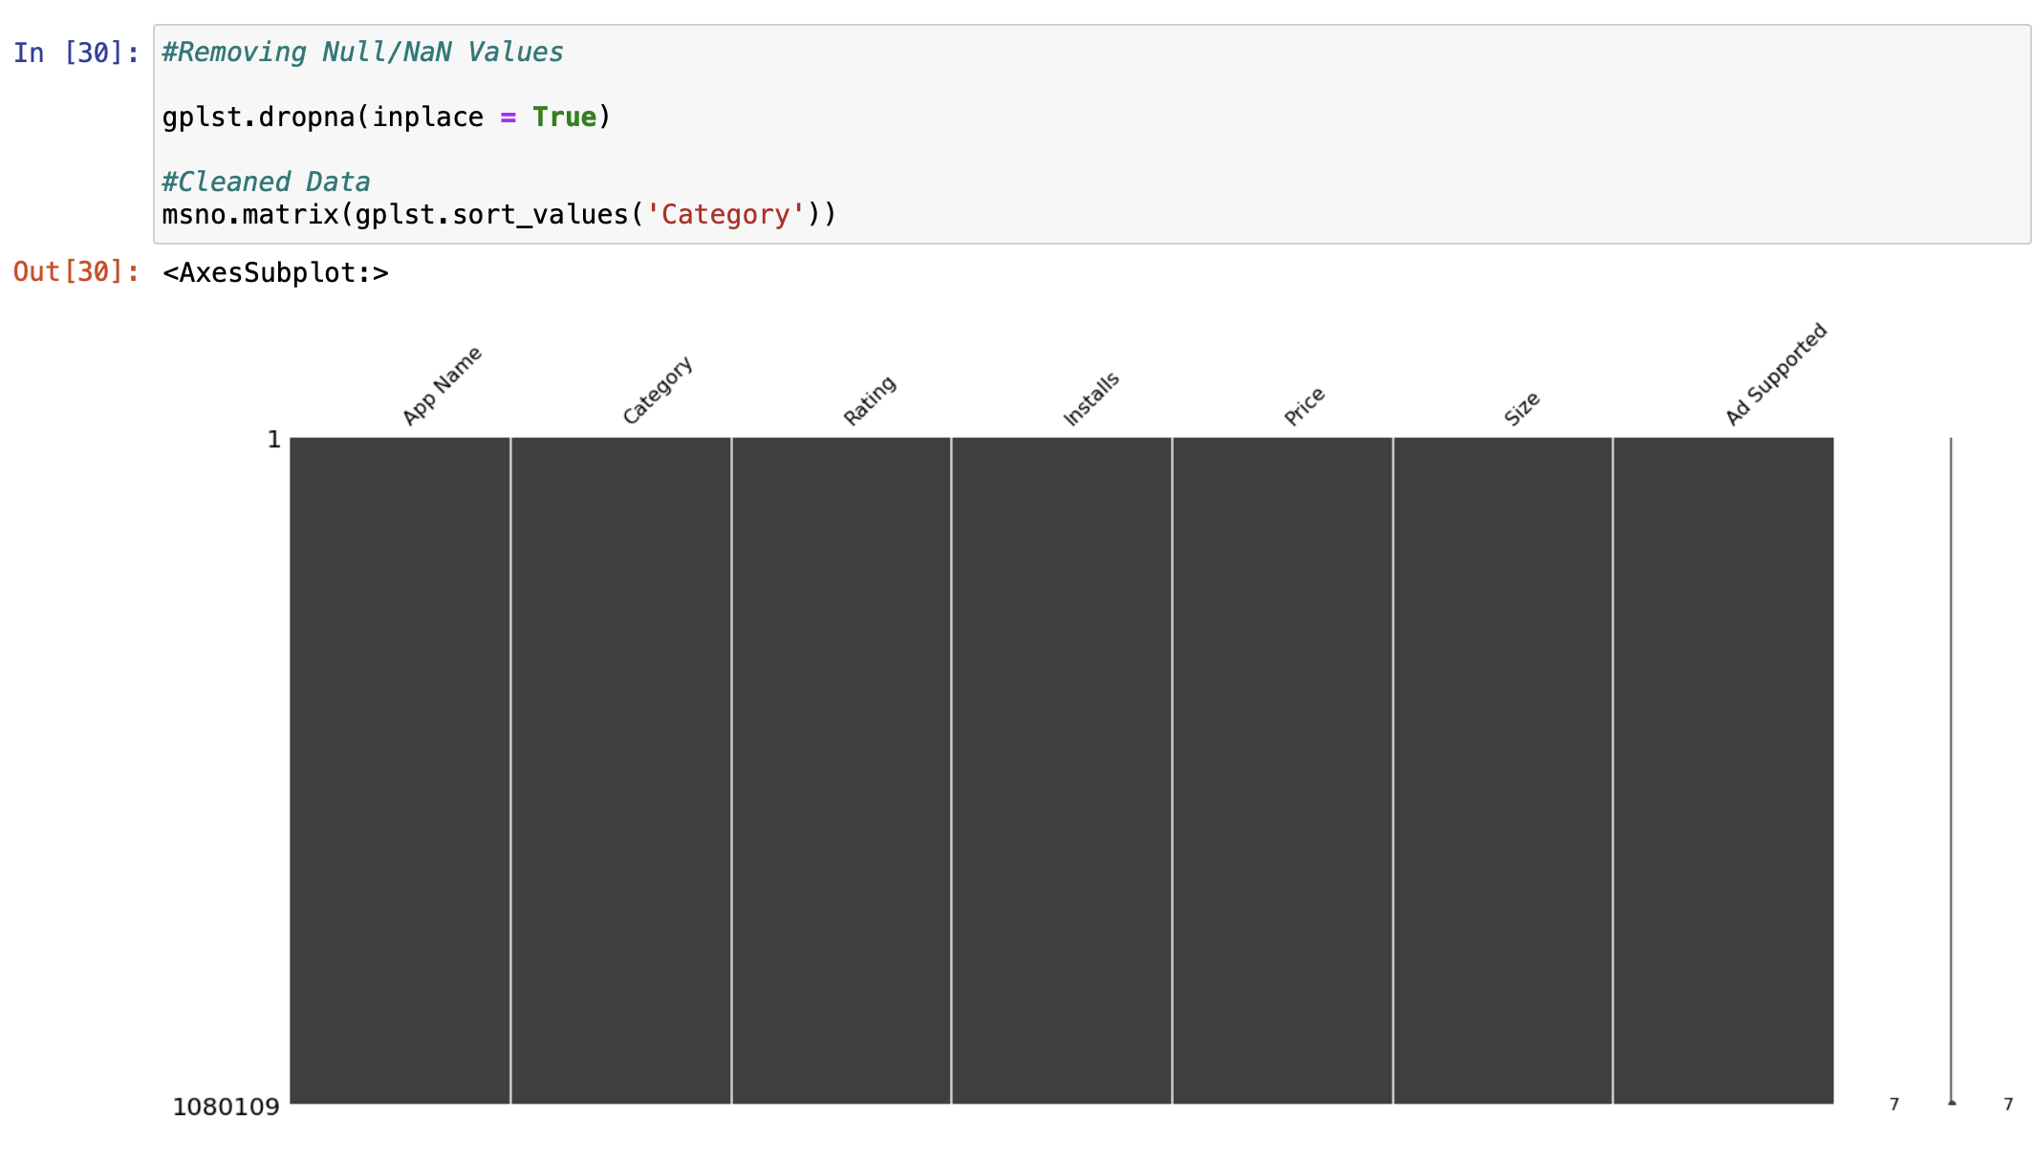
Removing Null/Nan Values

Slide 32
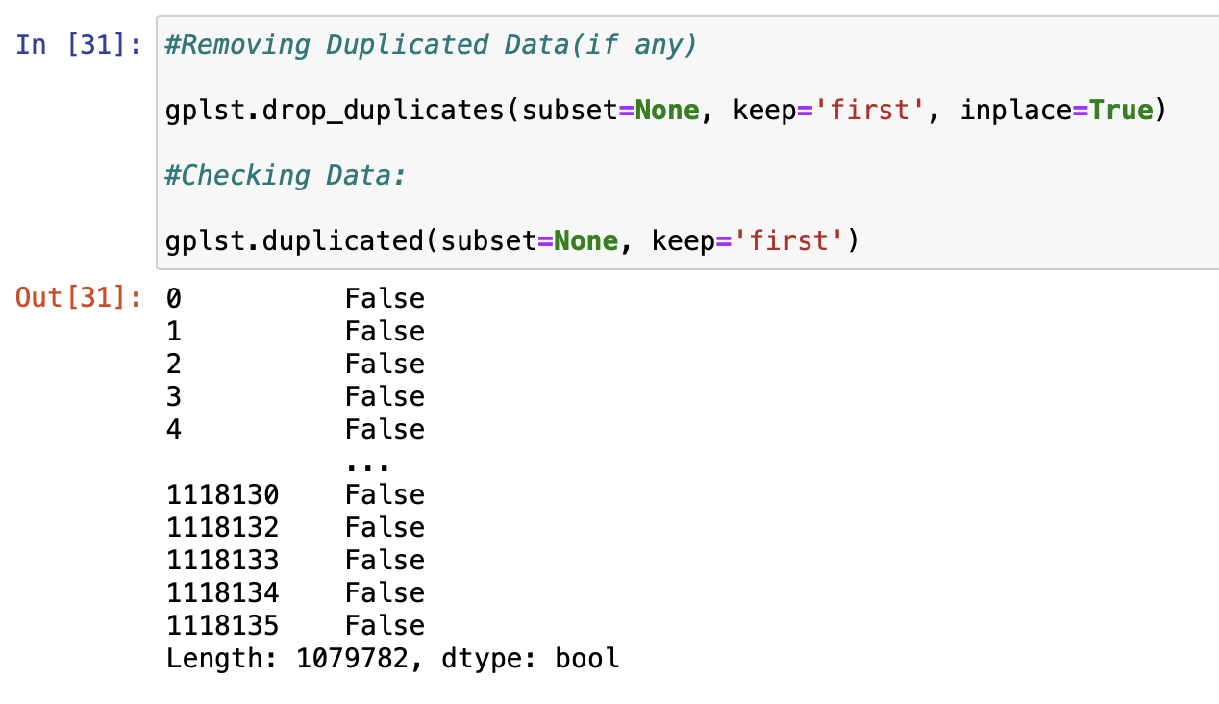
Removing Duplicated Data(if any)

Slide 33
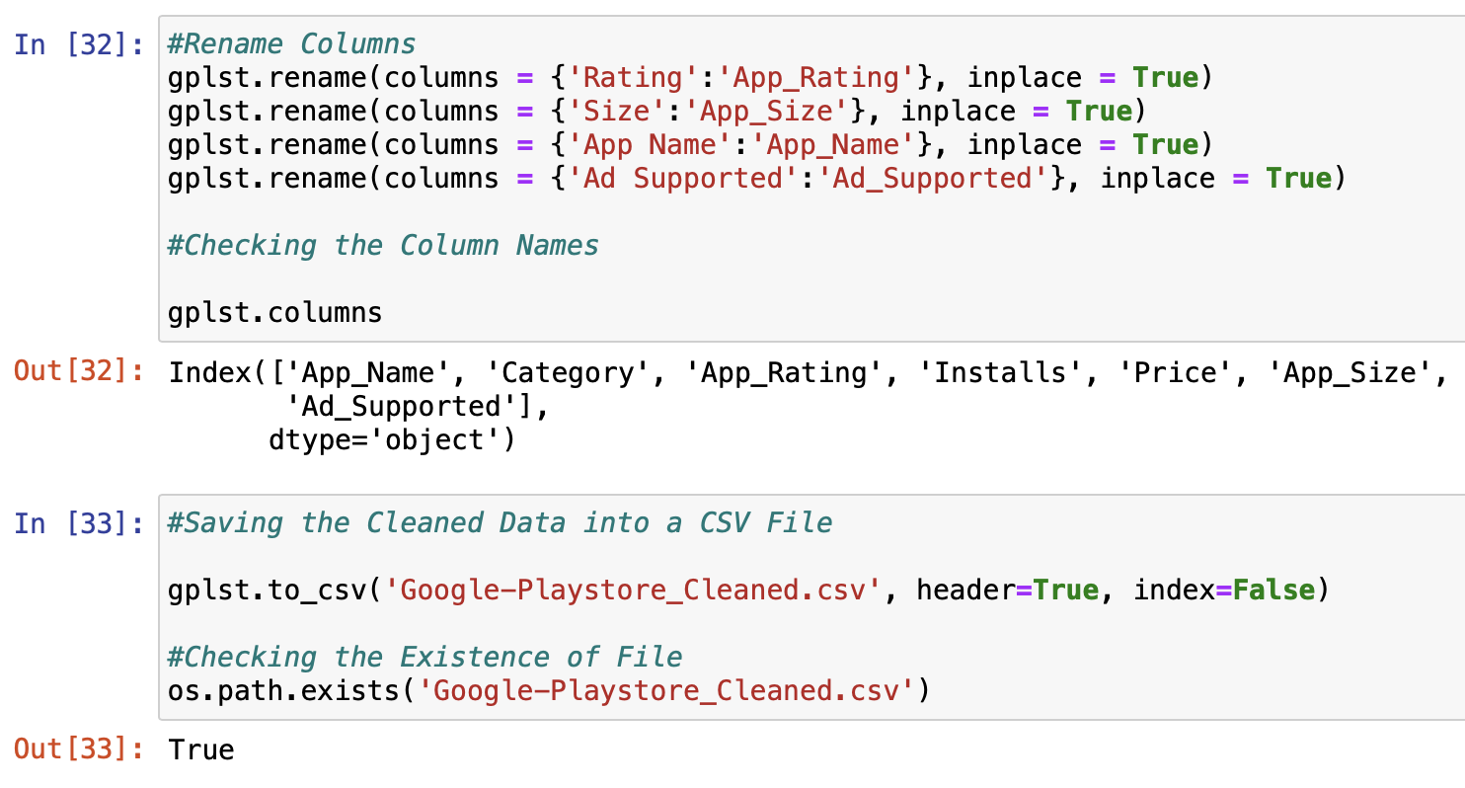
Renaming Columns
&
Storing the Cleaned Dataset

Slide 34
Data Analysis

Slide 35
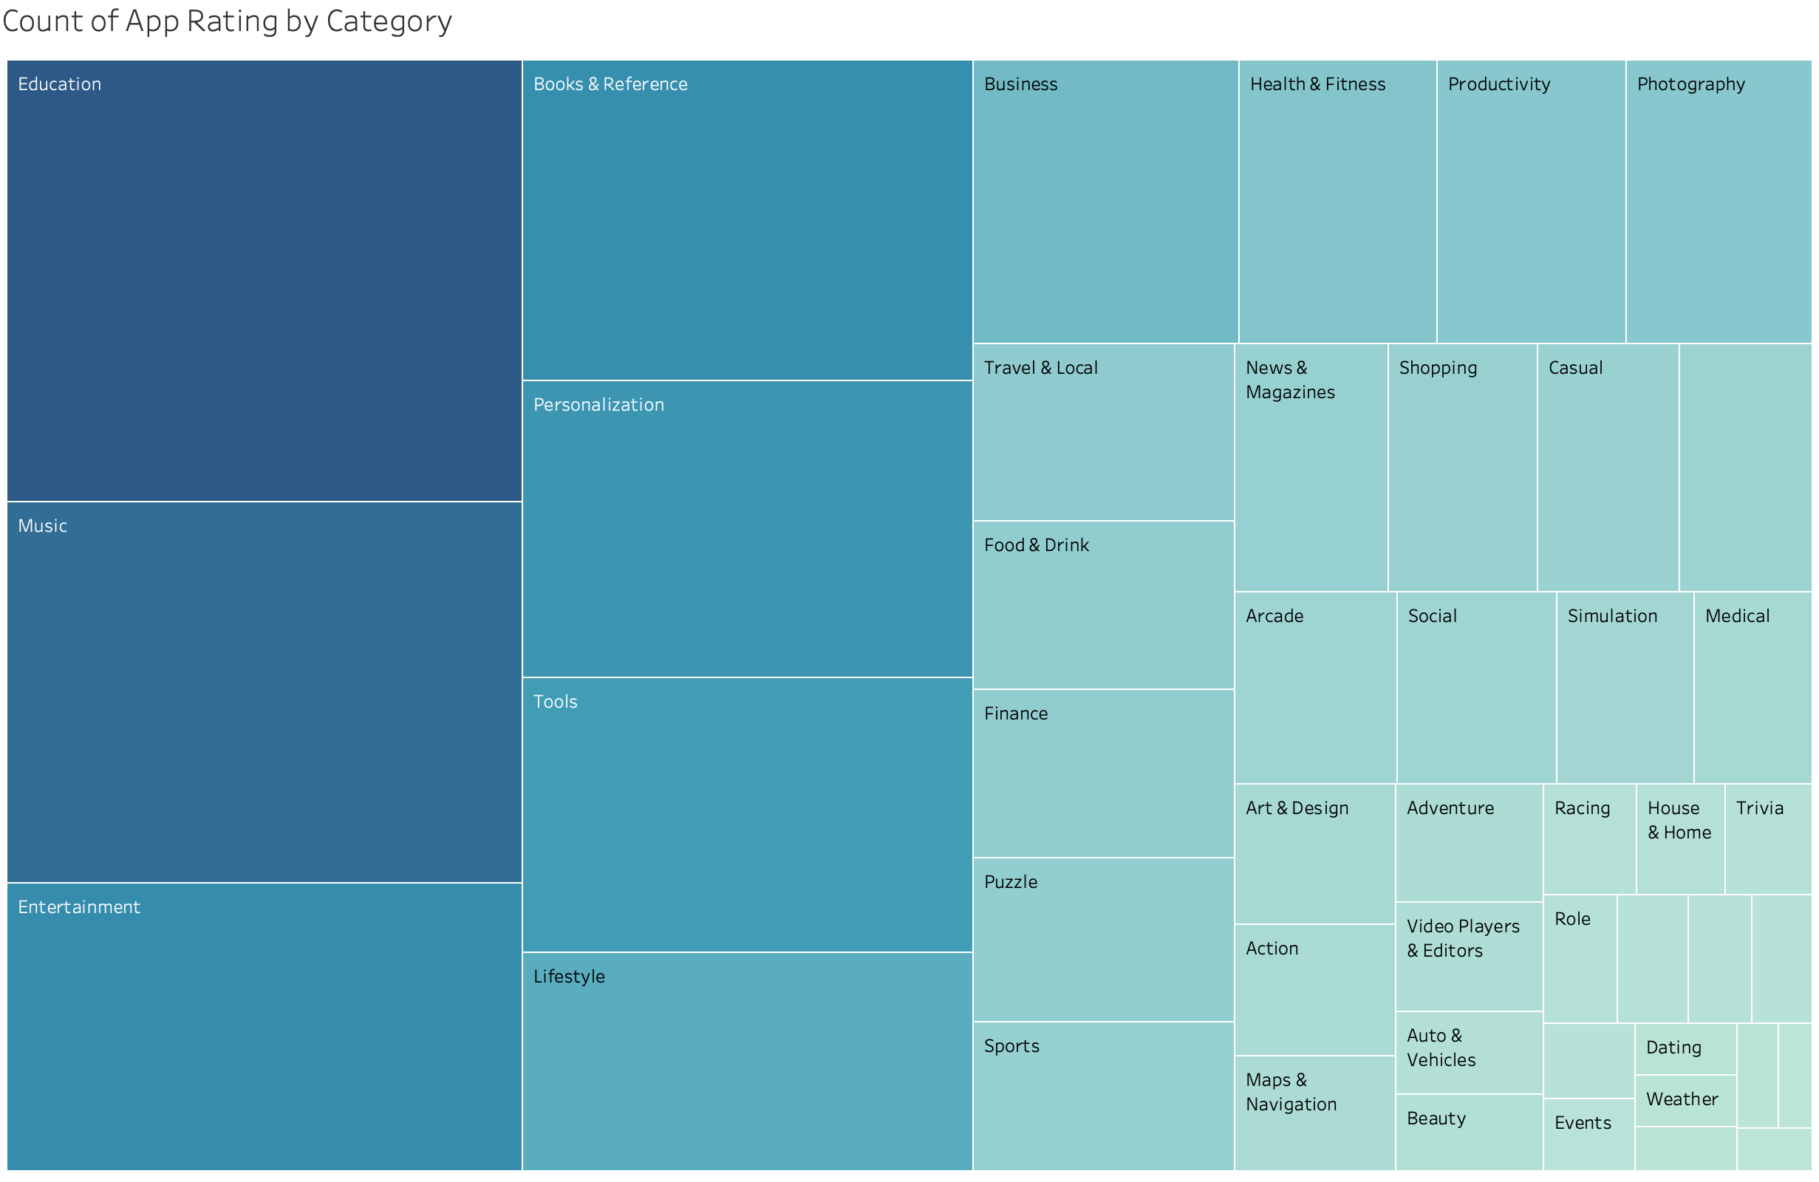
By looking at this graph we can clearly say that App Ratings for these fields Education , Music and Entertainment are very high compare to other fields.

Slide 36

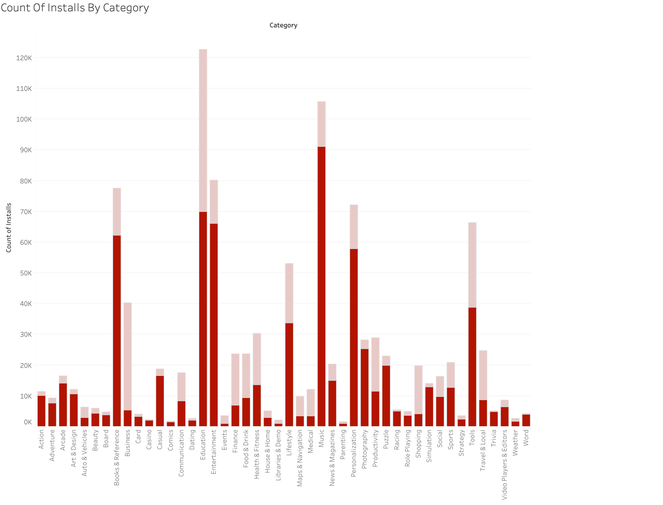
This Graph shows the number of installs by App category and filtered by Ad supported.
Light red depicts that it’s Ad supported
Dark red depicts that it’s not Ad supported
From this Graph we can say that most people are interested in Education, Music, Entertainment, Books, personalization and Tools.

Slide 37

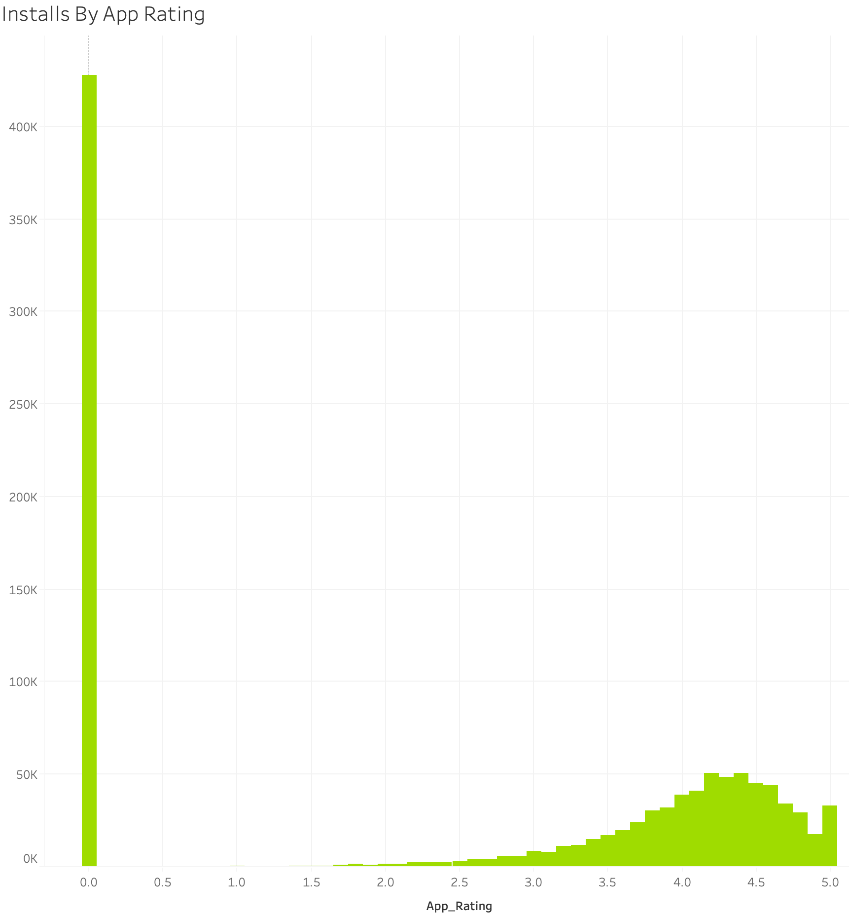
This graph shows Number of installs by App Rating
From this plot we can say that most people are installing apps that are not rated.
But on the other side people are liking to install apps which rated above 4 stars.

Slide 38
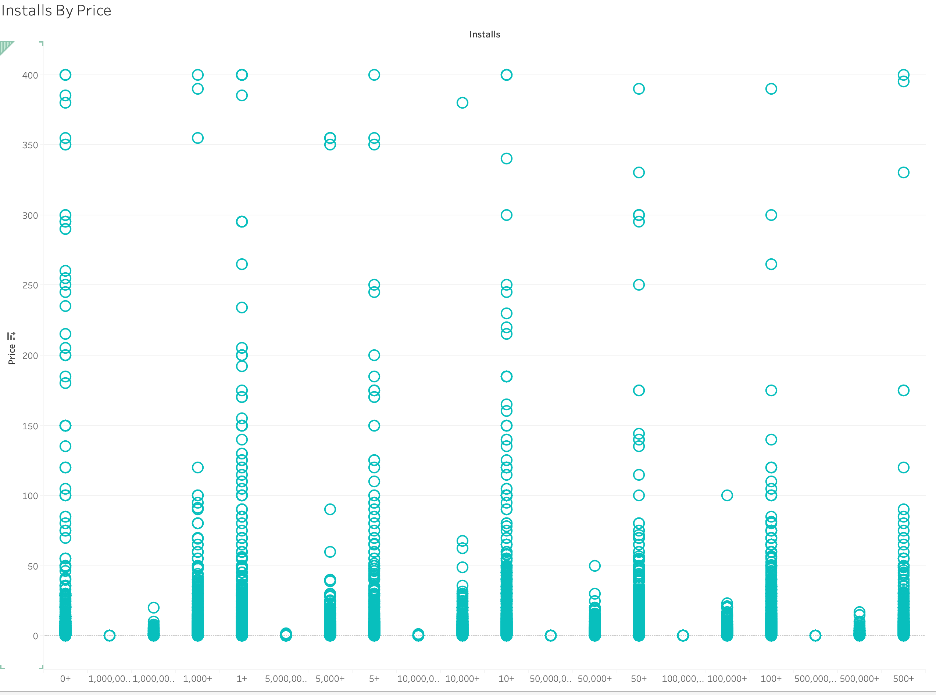
This Graph shows Number of installs by App Price
Number of installs are higher when the price of apps are lower.
Most People would like to install free apps rather than paid ones.

Slide 39
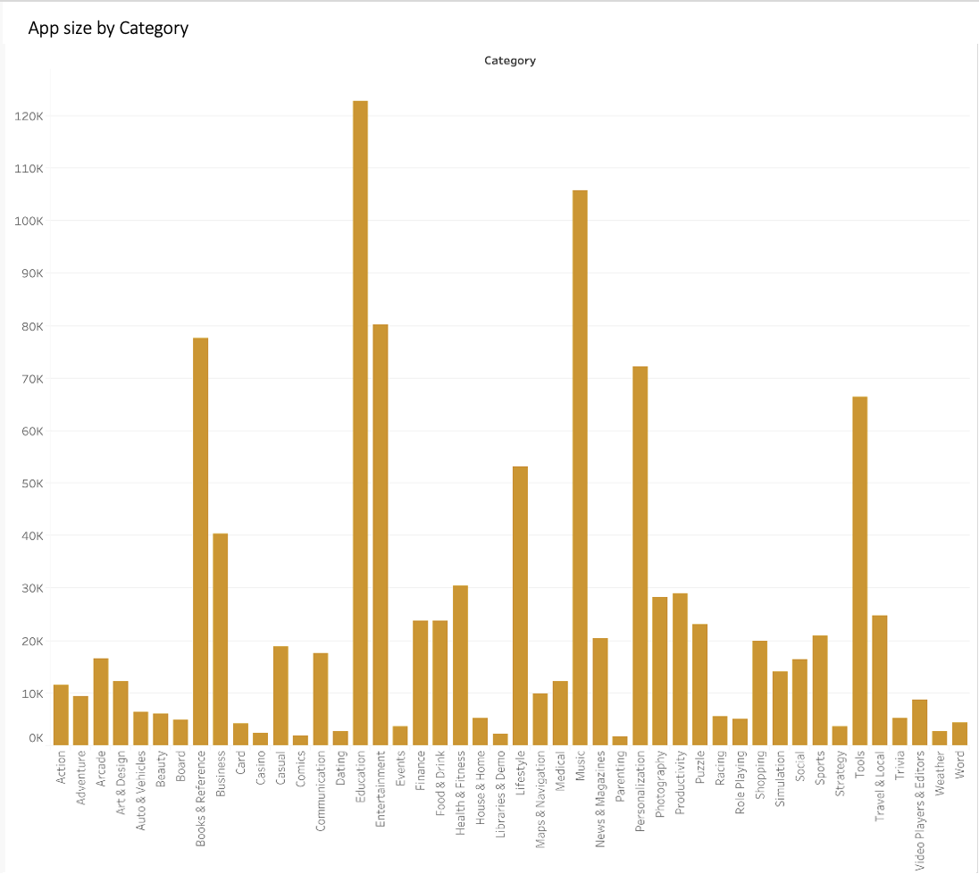
This Graph Shows App Size by Different Category
By comparing above graphs and this graph we can say that app size doesn’t matter for any person to install any app.

Slide 40
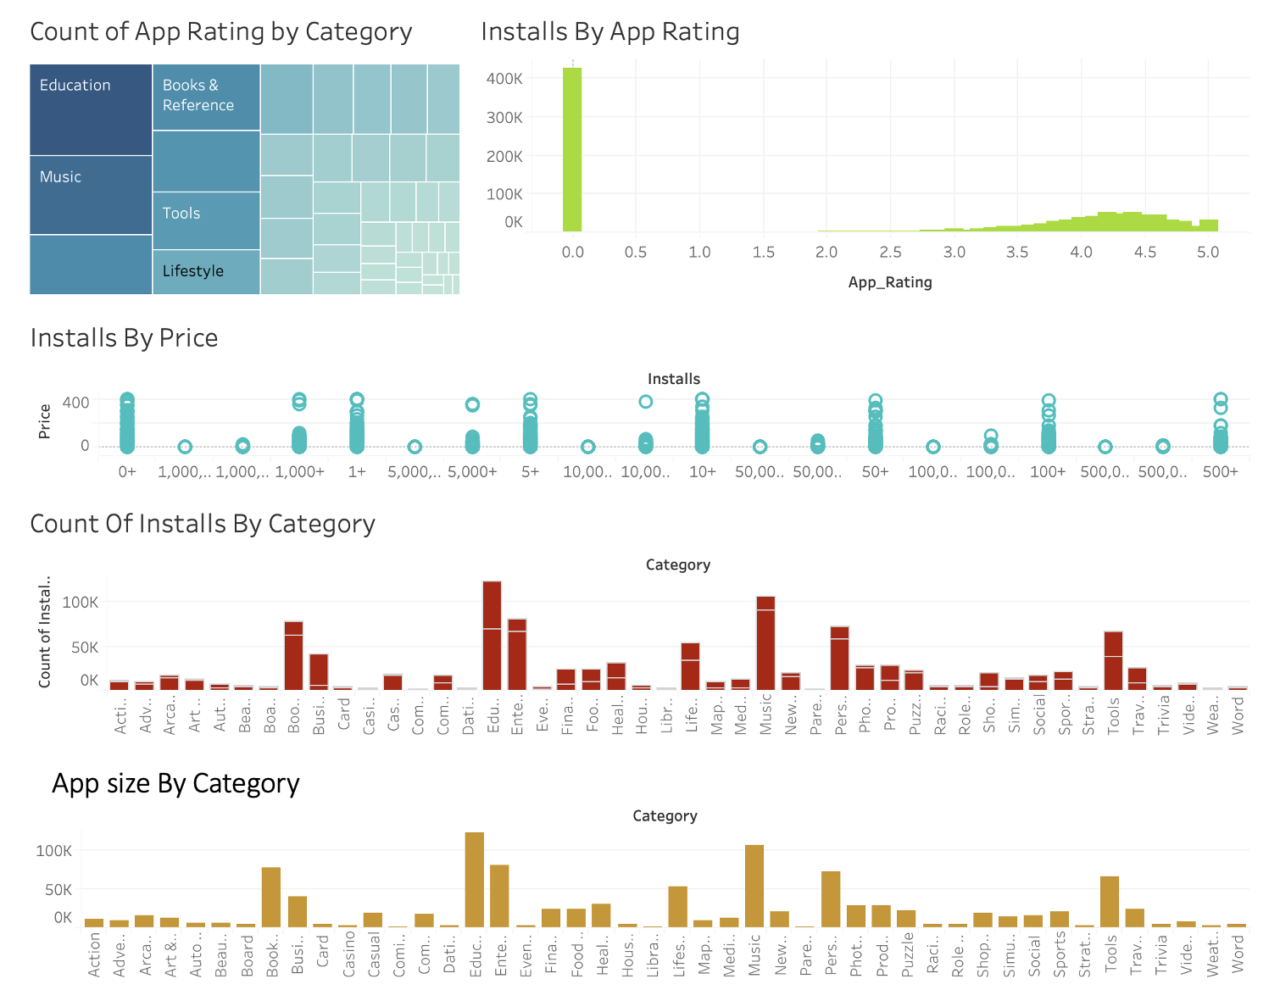
DAshboard

Slide 41
Conclusion
After performing all this analysis we can clearly say that most people are looking for free Education, Music, and Entertainment apps.
So, It’s better to build an app of this kind for any App Developer and App organization because this type of apps will have more installs on Google Play-store.

Slide 42
GithUb link for Code of this project
https://github.com/Vishal26199/Google-Playstore

